Slide 1
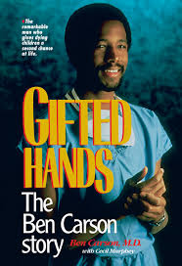
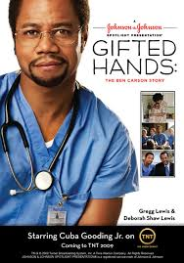
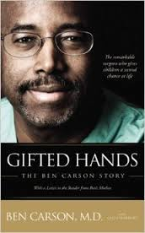
Gifted Hands
By Dr. Ben Carson
Modified by Ms. Hernández, 2014

Slide 2
Key Facts
Full Title · Gifted Hands: The Ben Carson Story
Author · Ben Carson, M.D. with Cecil Murphey
Genre · Autobiography
Date of First Publication · 1990

Slide 3
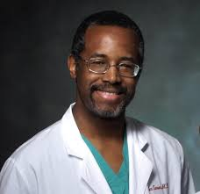
Key Facts
Narrator: Ben Carson
Point of view:
1st person: I, me , my, we, us, our
Tense: Past & Present
Purpose for writing:
To tell his story
To encourage and inspire others to persevere despite their problems

Slide 4
Setting = Time and Place
Ben’s childhood 1950’s &1960’s Detroit, MI &Boston, MA
Poverty
Racism

Slide 5
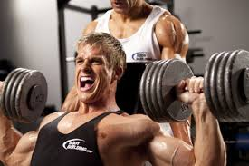
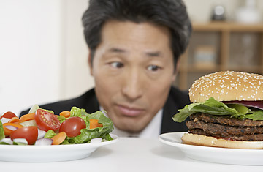
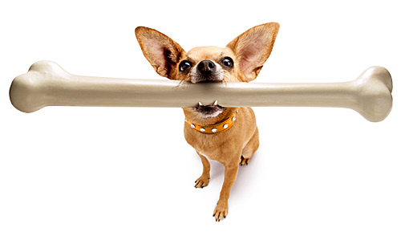
Themes
Theme = the author’s message, the lesson we should learn from the story
Perseverance/determination
You control your own actions
Hard work pays off
Education is the key to success
Think big!

Slide 6
Summary
Gifted Hands is an inspiring story about a frustrated inner-city black kid who lives in Detroit, Michigan with his mother and older brother. His faith in God helps him become the director of pediatric neurosurgery at Johns Hopkins University Hospital.

Slide 7
Summary
When Ben Carson was young, he lacked motivation and had terrible grades. He grew up without a father, and as he got older, developed a dreadful temper that could have landed him in jail. Ben's mother, though, convinced him he could make something of his life. Pure determination pulled Ben from the bottom of his class to the top. He continued to soar through high school and was awarded a scholarship to Yale University. He then attended the University of Michigan Medical School and at age 33, became the director of pediatric neurosurgery.

Slide 8
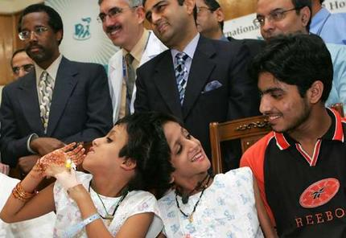
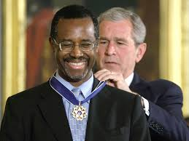
Summary
Today, Dr. Ben Carson holds 20 honorary doctorates. He shares his experiences with racism and his attempts to fight prejudice, as well as breathtaking stories in the operating room and surgeries that made headlines around the world. One amazing case was when he separated Siamese twins joined at the head in 22 hours of surgery. He has worked medical miracles and saved many lives.

Slide 9
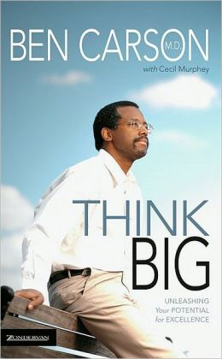
Summary
This book is an exciting, motivating autobiography about a man who lives to help others. Today, he's one of the world's most renowned neurosurgeons. Gifted Hands is filled with fascinating case histories and delivers a powerful message about never giving up on goals and to "think big."

Slide 10
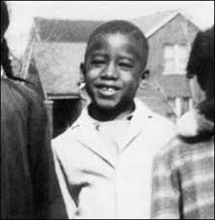
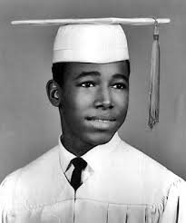
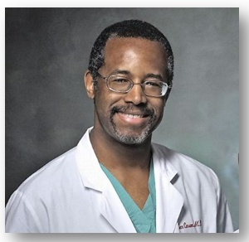
Ben Carson
Main character/narrator
Didn’t always do well in school
Had a bad temper
Strong faith in God
Persevered to meet his goals
Scholarship to Yale
Became a famous doctor
Married with 3 kids
Author of several books
Considering running for president

Slide 11
Other Main Characters
Sonya Carson: Ben’s mom
Curtis Carson: Ben’s brother

Slide 12
Chapters 1-3
Ch. 1: “Goodbye, Daddy”
Ben’s father leaves his family
Ben learns why
Ben and Curtis have to learn to live without their father

Slide 13
Chapters 1-3
Ch. 2: “Carrying the Load”
Sonya Carson deals with a lot of stress:
Single mother
Multiple jobs
No support from ex-husband
illiterate
Ben attributes his success to his mother & describes her as:
Hardworking
Goal-oriented
Intelligent
Refuses to settle for less

Slide 14
Chapters 1-3
Ch. 3: “Eight Years Old”
Ben describes life after moving to Boston
Tenements
Rats
Drunks
His first religious experience
Ben decides he wants to become a doctor
They move back to Detroit
Ben was getting bad grades
Kids made fun of him and called him dumb

Slide 15
Vocabulary

